Slide 1
Getting started with Azure AI Studio
Swaminathan Vetri
Lead Platform Architect, Maersk

Slide 2

About Me
Swaminathan Vetri (Swami)
Lead Platform Architect – Maersk
Building Order Handling platform using Cloud native event driven architecture on k8s, Azure PaaS services
Dad of 2 little princess ☺
Microsoft MVP (2016-2022)
Twitter - @svswaminathan
GiHub - @swaminathanvetri
LinkedIn – SwaminathanVetri
Blogging, Public Speaking, Community engagements, Photography, Dancing, Table tennis

Slide 3
AI safety and security
Copilot Studio
Microsoft Copilot
Your copilots
Microsoft apps
Copilot Stack
AI orchestration
Your data
Foundation models & AI toolchain
AI infrastructure
Microsoft Cloud

Slide 4
What is Azure AI Studio
AI Studio is a trusted and inclusive platform that empowers developers of all abilities and preferences to innovate with AI and shape the future.

Slide 5
Why Azure AI Studio?
Build generative AI applications on an enterprise-grade platform.
Directly from the studio you can interact with a project code-first via Visual Studio Code (Web).
Seamlessly explore, build, test, and deploy using cutting-edge AI tools and ML models, grounded in responsible AI practices.
Build together as one team. Your AI Studio hub provides enterprise-grade security, and a collaborative environment with shared files and connections to pretrained models, data and compute.
Organize your way. Your AI Studio project helps you save state, allowing you iterate from first idea, to first prototype, and then first production deployment. Also easily invite others to collaborate along this journey.

Slide 6
What does it offer?
API and model choice
Azure AI services
Azure OpenAI Service
Build Intelligent Apps with Industry leading APIs
Model catalog
Managed compute and serverless APIs
Model benchmarks
Compare models by performance and key parameters
Discover models for your use cases
Deploy serverless models

Slide 7
Complete AI toolchain
Azure AI Search
Fine-tuning
Ground models on your secure data
Prompt flow
Orchestrate and debug AI workflows
Open frameworks
Tracing and debugging
Evaluations
Streamline model and app evaluations

Slide 8
Responsible AI tools and practices
Responsible AI principles
Design apps responsibly
Azure AI Content Safety
Safeguard apps with Configurable filters and controls

Slide 9
Enterprise grade production at scale
Collaborative hubs
LLMOps
Deploy to Production
Monitoring & observability
Operationalize and monitor workflows
IT governance
Enable developer agility and enterprise governance at scale
Security & privacy
RBAC
Microsoft Copilot Copyright Commitment

Slide 10

Azure AI Studio (2)
Azure AI Studio - Overview
A unified platform for developing generative AI apps and custom copilot experiences
Unified platform
Comprehensive AI Tools
Code-centric Developer experiences
Data & search
Data integration
Hybrid vector search
Foundation models
Best in class and open model catalog
Multimodal
Safe & responsible AI
Content classification
Model monitoring
Jailbreak risk detection
Full development lifecycle
Prompt flow
LLMOps
Model monitoring
Explore, build, evaluate, and deploy AI responsibly
Notes:
Azure AI Studio unifies various AI services for a seamless experience, catering to diverse AI models and data sources.
Incorporates Microsoft's data and search technologies, OpenAI foundation models and other opensource AI and models from partners.
Emphasizes the importance of building AI responsibly with advanced safety tools.
Development lifecycle that supports emerging trends, like LLMOps for managing lifecycle and versioning of AI systems.

Slide 11
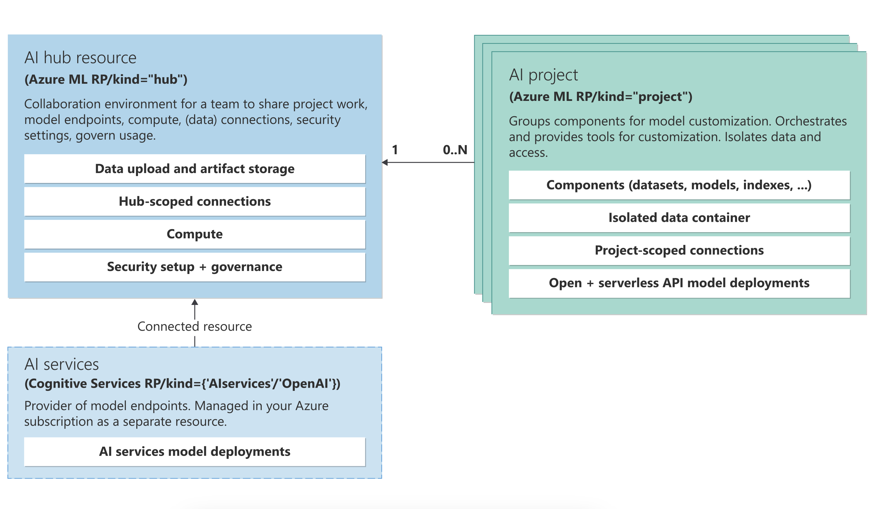
Azure AI studio Architecture
Source: learn.microsoft.com/en-us/azure/ai-studio/media/concepts/resource-provider-connected-resources.svg

Slide 12
Is it yet another Studio ☺ ?
Azure ML Studio
Azure Open AI Studio
Copilot Studio

Slide 13
Demo – Intro to Azure AI Studio
Notes:
Tab 1:
- Create projects
- Show settings (Azure AI Resource / Connections / Compute Infrastructure)
- Show Deployments
- Show Playground (Select deployments)
-- Ask question: How much do the TrailWalker hiking shoes cost?
Tab 2:
- Ground model with own data (Connected to data source)
- Ask question: How much do the TrailWalker hiking shoes cost?
- Show in documentation
Tab 3:
- Translate questions to Greek
-- Ask question: Πόσο κοστίζουν τα παπούτσια πεζοπορίας TrailWalker;
Tab 4:
- Show system prompt
You are an AI assistant
You always response in a rhyme.
You are friendly and funny
- Ask what can you tell me about Greece?
Tab 4:
- Evaluation
- Click manual evaluation in playground
- Show manual evaluation output

Slide 14
Get started skilling with AI on Microsoft Learn
Build AI skills, connect with the community, earn Microsoft Credentials, learn from experts, and take the Cloud Skills Challenge.
aka.ms/LearnAtAITour

Slide 15
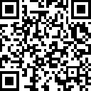
Join the Azure AI Community on Discord
Connect with fellow enthusiasts, engage with Microsoft experts and MVPs, discuss your favorite sessions, and delve into AI discussions. Your space to ask, share, and explore!
aka.ms/AzureAI/Discord

Slide 16
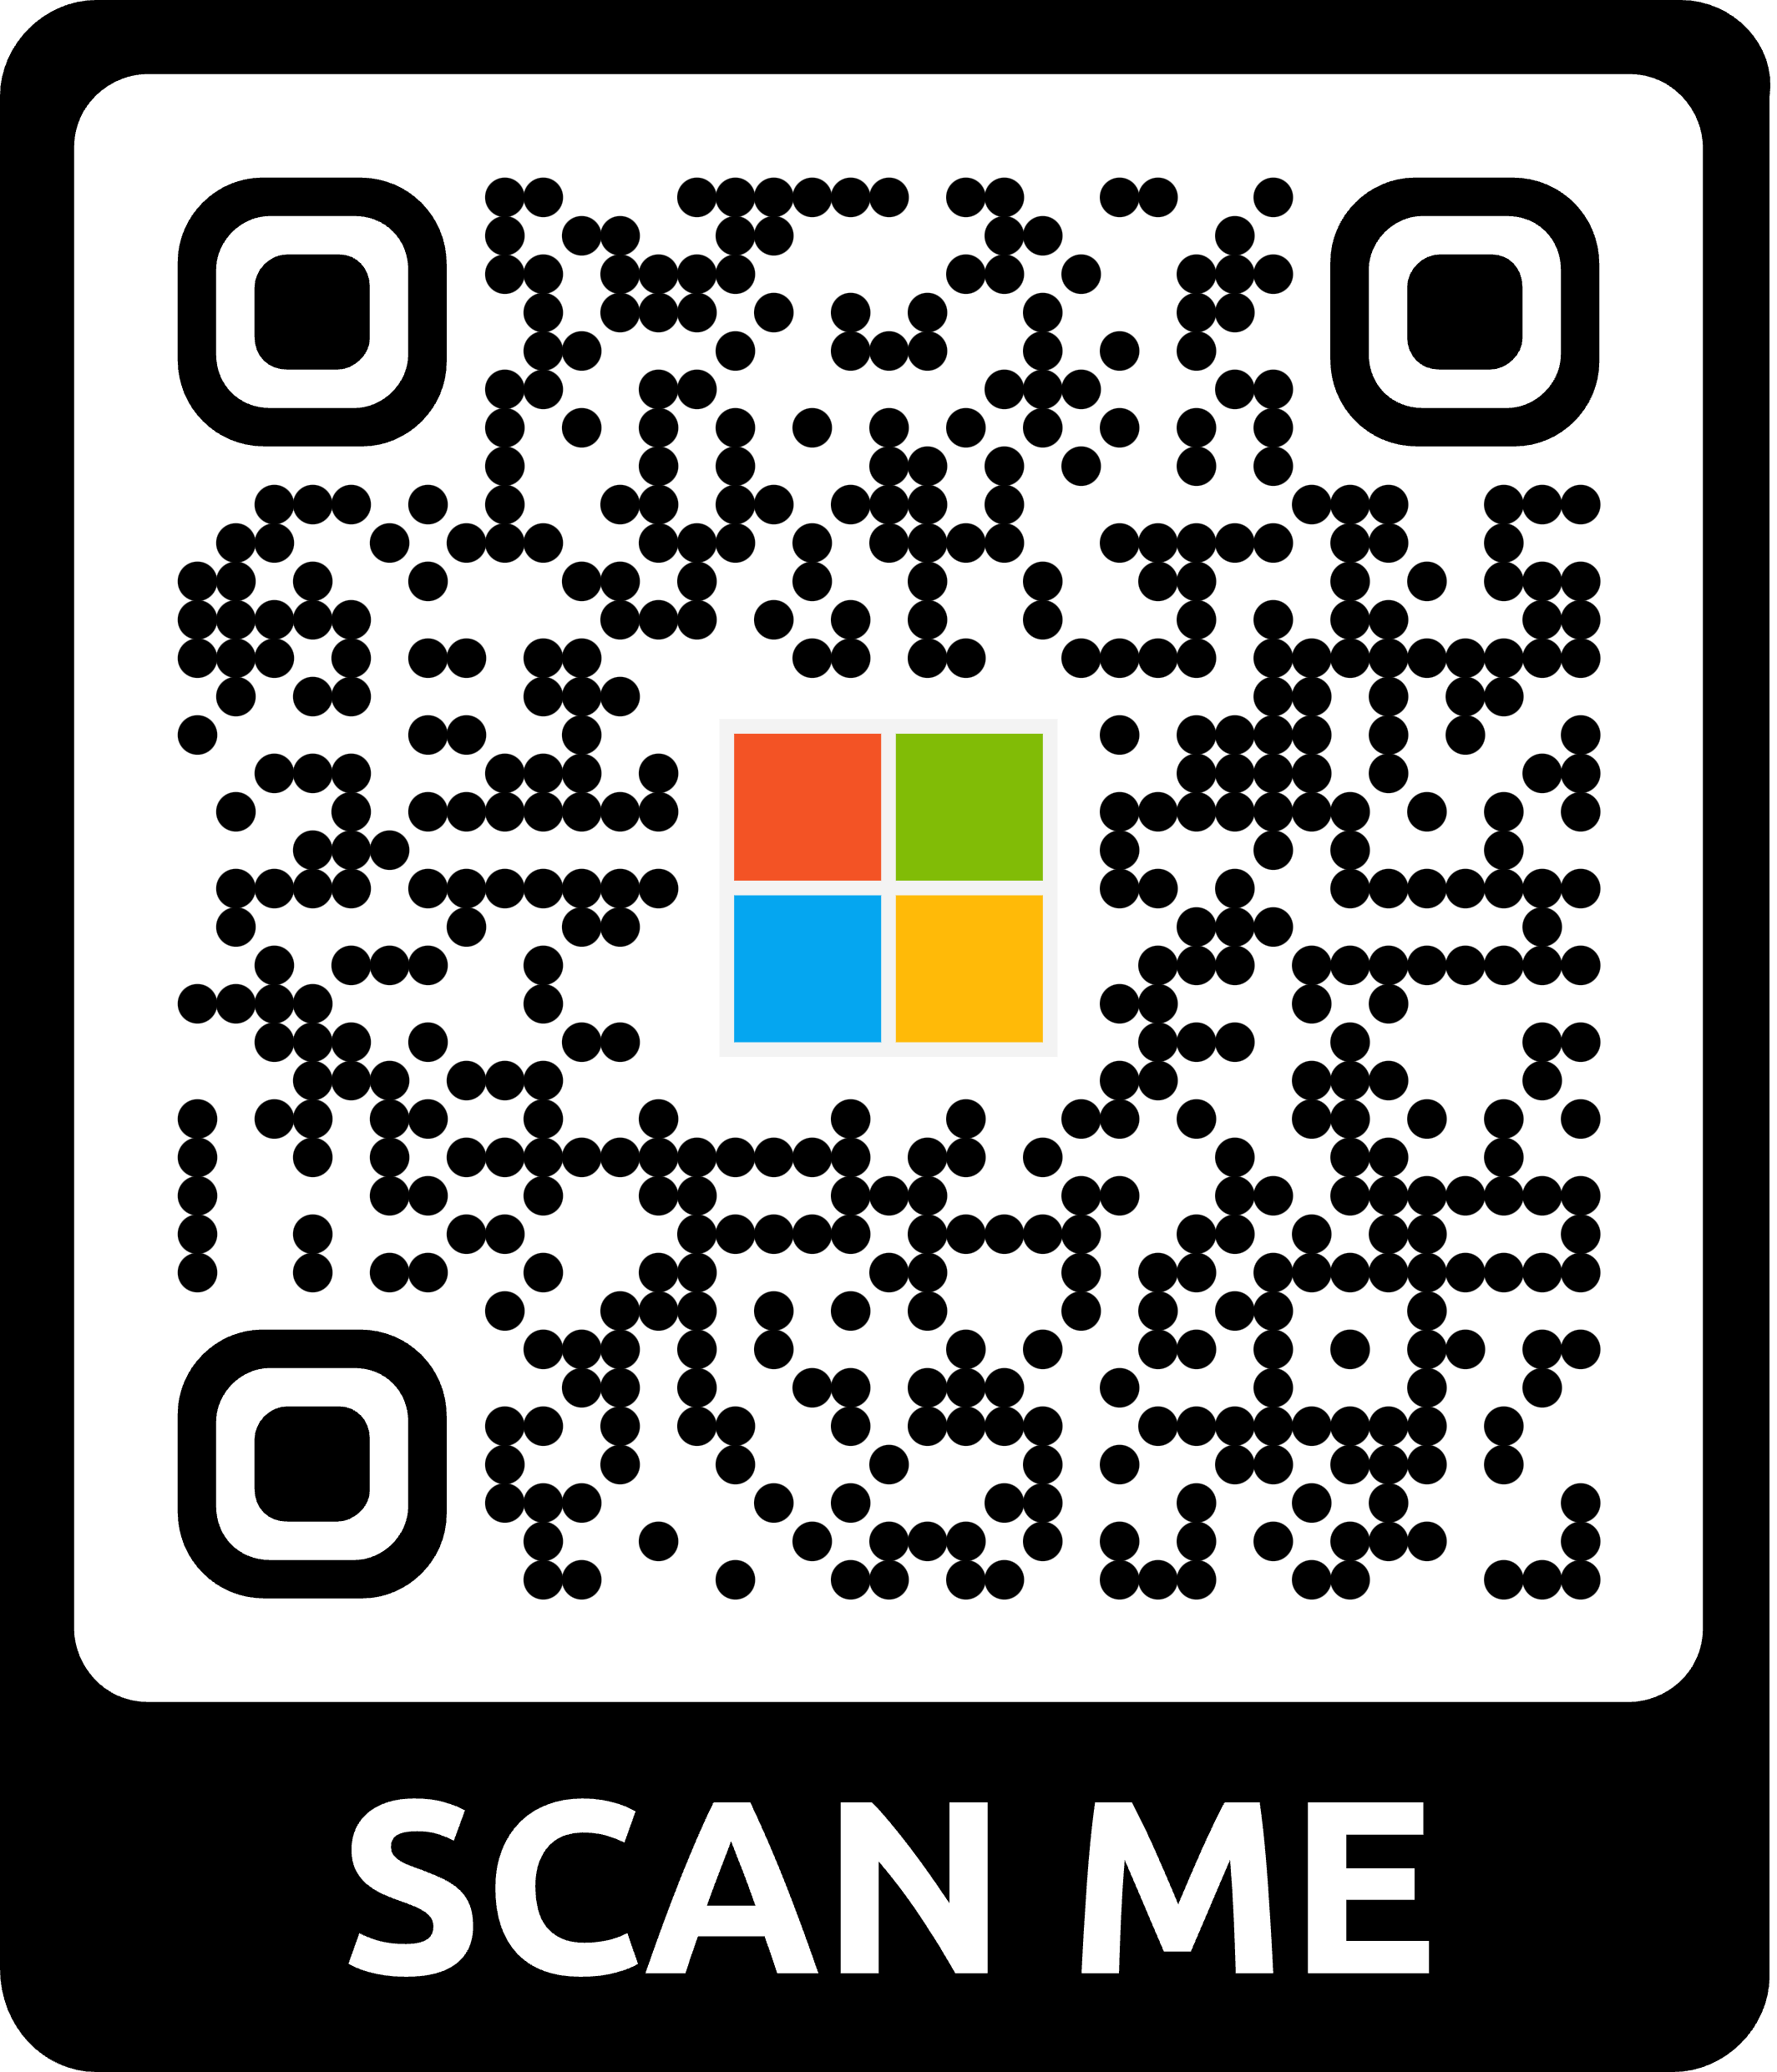
Microsoft wants to hear from YOU!
Attendee Survey
Season of AI | Microsoft Community
aka.ms/AttendeeSurveySeasonOfAI
2024

Slide 17
🙋🏻‍♀️ ?? 🙏 X -@svswaminathan GitHub/ LinkedIn - @swaminathanvetri

